Slide 1
Microservices

Slide 2
Microservice Architecture is a Service Oriented Architecture. In the microservice architecture, there are a large number of microservices. By combining all the microservices, it constructs a big service. In the microservice architecture, all the services communicate with each other.

Slide 3
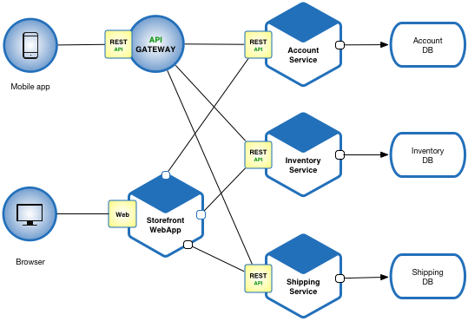

Slide 4
Enabling rapid, frequent and reliable software delivery
In order to thrive in today’s volatile, uncertain, complex and ambiguous world, businesses must be nimble, agile and innovate faster. Moreover, since modern businesses are powered by software, IT must deliver that software rapidly, frequently and reliably .
Rapid, frequent, reliable and sustainable delivery requires the success triangle, a combination of three things:
Process - DevOps as defined by the DevOps handbook
Organization - a network of small, loosely coupled, cross-functional teams
Architecture - a loosely coupled, testable and deployable architecture
Teams work independently most of the time to produce a stream of small, frequent changes that are tested by an automated deployment pipeline and deployed into production.

Slide 5
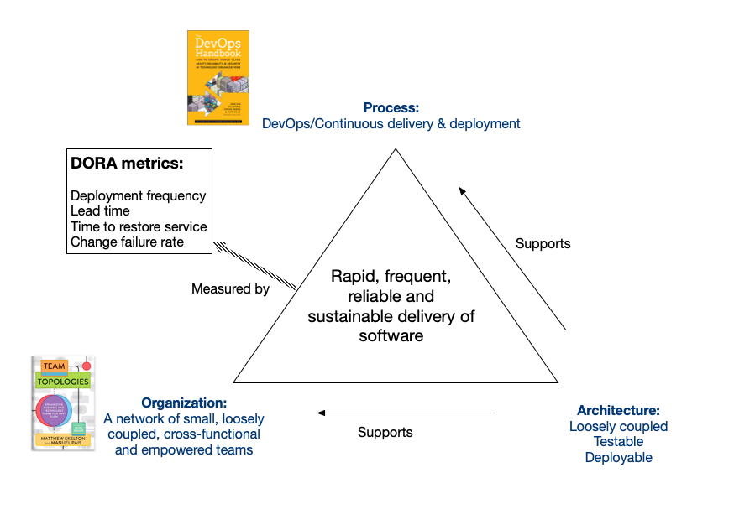

Slide 6
When you outgrow your monolithic architecture
Let’s imagine that you responsible for a business critical business application that has a monolithic architecture and you are struggling to meet the needs of the business. Should you consider migrating to a microservice architecture?
The short answer is that it depends.

Slide 7
In many cases, once you have embraced the success triangle, your monolithic architecture is sufficiently loosely coupled, testable and deployable to enable rapid software delivery.
But sometimes an application can outgrow its monolithic architecture and become an obstacle to rapid, frequent and reliable software delivery. This typically happens when the application becomes large and complex and is developed by many teams. For example, its deployment pipeline become a bottleneck. When this occurs, you should consider migrating to microservices.

Slide 8
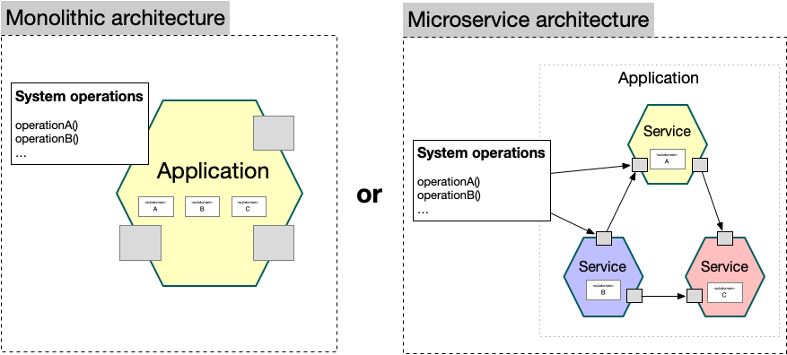

Slide 9
Designing a microservice architecture
But what’s critically important is designing a good service architecture:
identifying services;
defining their responsibilities;
their APIs and collaborations.
If you get it wrong you risk creating a distributed monolith, which will slow down software delivery.

Slide 10
What’s more, designing the service architecture is challenging because it’s a creative activity - not something you can buy, download or read in a manual.
Assemblage is an architecture definition process that you can can use to define your microservice architecture. It distills your requirements into system operations and subdomains; uses the dark energy and dark matter forces to group the subdomains into services; and designs the distributed system operations.

Slide 11
Assemblage - a microservice architecture definition process
The essence of applying the Microservice architecture pattern is defining the service architecture: identifying the services, defining their responsibilities, their APIs and their collaborations (with other services).
Choosing the right technical architecture - deployment platform, message broker, etc. - also matters. But that’s a far easier and much less important task. That’s because if you define your services incorrectly you will create a fragile, and difficult to maintain distributed monolith that can threaten your organization’s very existence. And to make matters worse, defining the service architecture isn’t just a matter of reading the manual. It’s a design activity that involves numerous, and often tricky trade-offs.

Slide 12
Overview of Assemblage
The input to the architecture definition process consists of the application’s requirements, e.g. user stories/scenarios, non-functional requirements, wireframes, etc. The output of the process is a service architecture, which consists of the services, and their responsibilities, APIs, and collaborations.

Slide 13
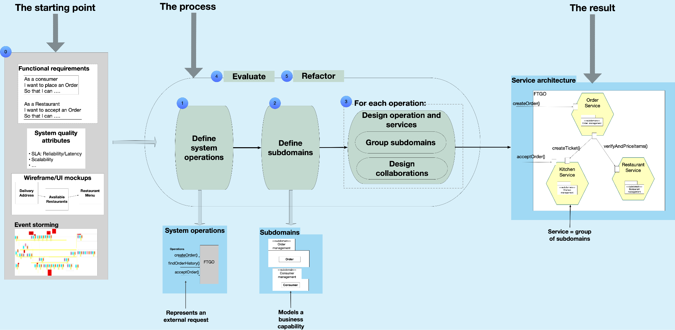

Slide 14
The architecture definition process consists of the following steps:
Discovering system operations
Defining subdomains
Designing services and their collaborations
Evaluating a microservice architecture
Refactoring a microservice architecture

Slide 15
Step 1: Discovering system operations
The first step of the process distills the requirements into a set of system operations. A system operation is an invokable behavior implemented by the application. For example, an e-commerce application would typically implement operations such as createCustomer(), createOrder(), cancelOrder() and findOrderHistory(). A system operation reads and/or writes one or more business entities, a.k.a. DDD aggregates, such as Customer and Order. The system operations model the application’s black box behavior.
A system operation is technology independent. But the actual implementation will be invoked in one of several ways. It might, for example, be invoked by a HTTP request or a message. Alternatively, a system operation might be triggered by the passing of time, eg. a monthly batch job.

Slide 16
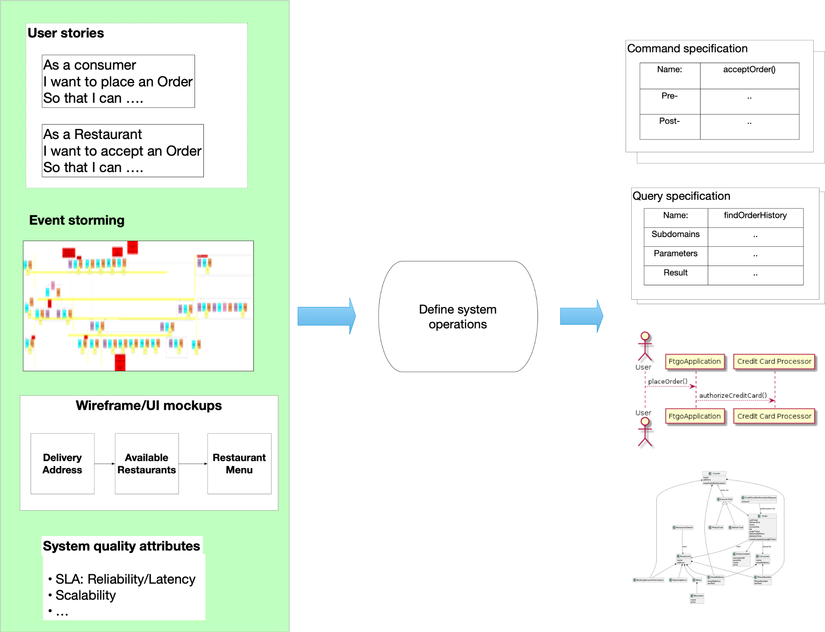

Slide 17
Step 2: Defining subdomains
The second step of the process defines the subdomains. A subdomain is an implementable model of a sliver of business functionality, a.k.a. business capability. Each subdomain is owned by a small team. A subdomain consists of the aggregates acted upon by system operations. In Java application, for example, a subdomain would consist of Java classes.

Slide 18
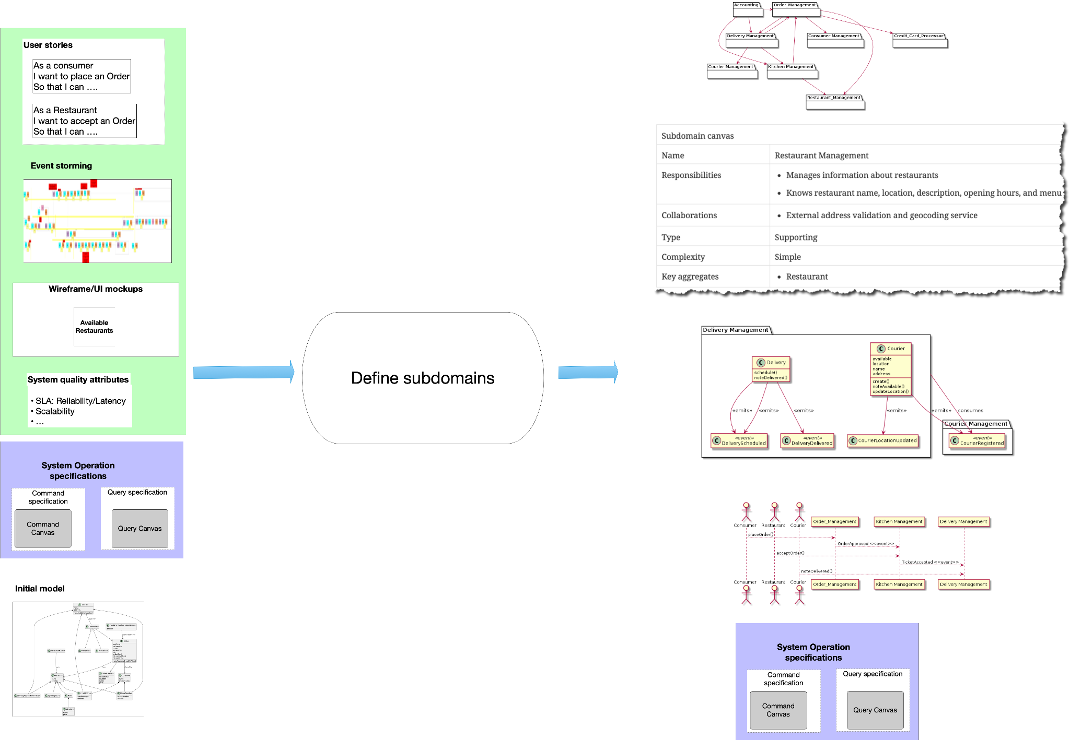

Slide 19
Step 3: Designing services and their collaborations
The third step groups the subdomains to form services and designs distributed system operations using the service collaboration (e.g. Saga, API Composition, and CQRS) patterns.
The dark energy and dark matter forces drive the definition of services and the design of system operations.
The output of the third step is a candidate architecture that is either a monolithic architecture (i.e. a single service) or a microservice architecture (two or more services). The architecture documentation includes a microservice canvas for each service.

Slide 20
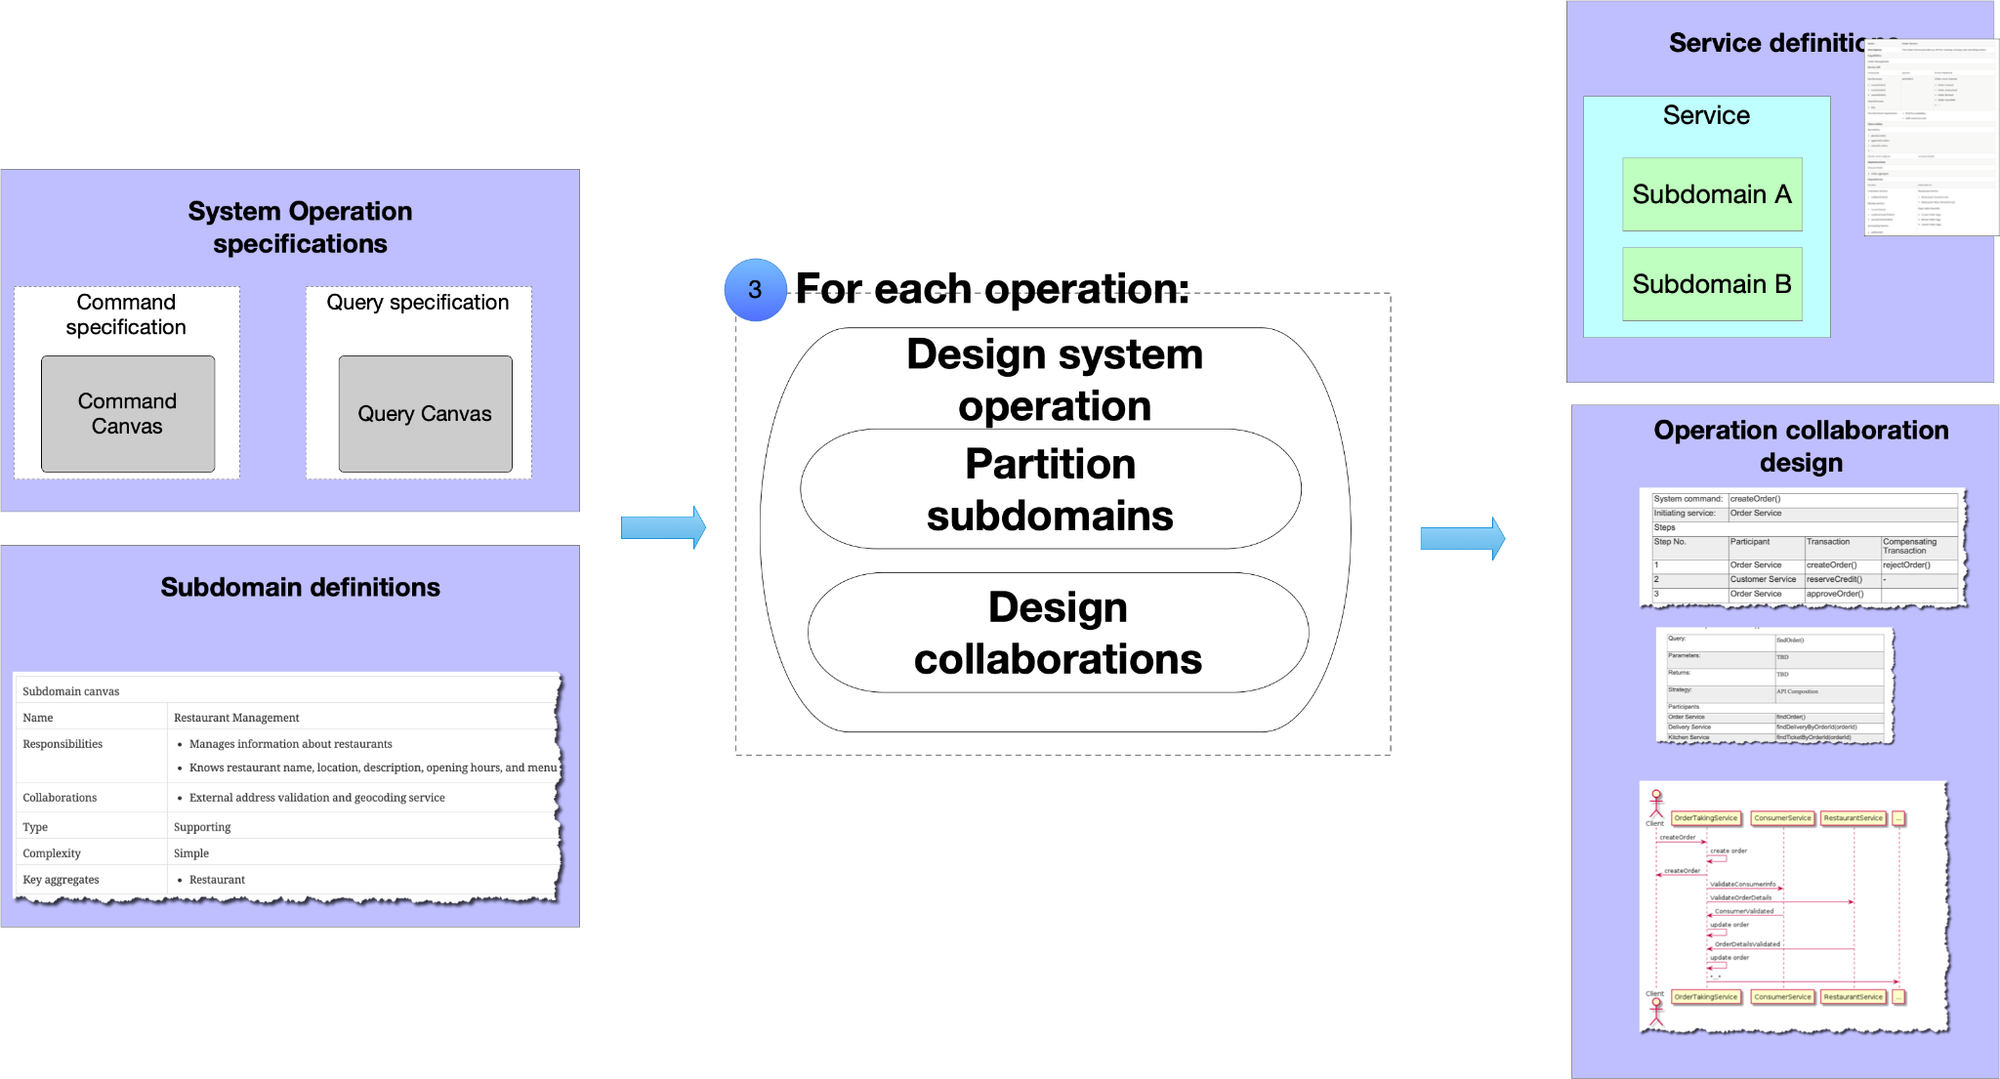

Slide 21
Step 4: Evaluating the microservice architecture
The fourth step evaluates the architecture to identify architectural issues/smells that are potential violations of the dark energy and dark matter forces.
Examples of architectural issues/smells include
Teams that lack of autonomy because too many teams work together on the same service
Services that repeatedly change in lock step due to design time coupling
Operation that have low availability and high latency because they span too many service and require too many network roundtrips
The output of fourth step is a list of potential architectural issues.

Slide 22
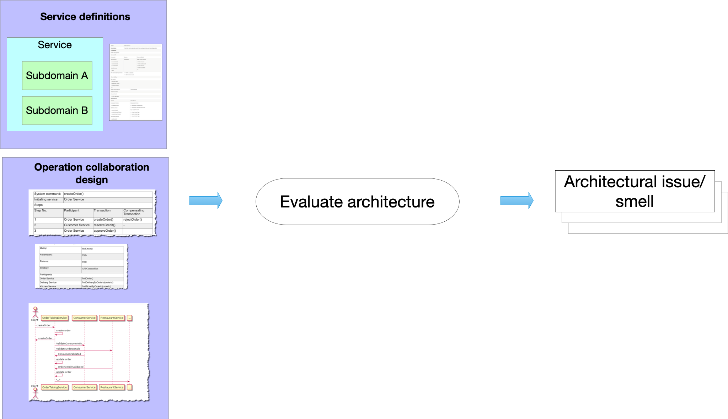

Slide 23
Step 5: Refactoring the microservice architecture
The fifth and final step refactors the architecture to eliminate architecture smells identified in the previous step. There are four levels of refactorings:
System operations - e.g. change collaboration patterns
Services - eg. move subdomains between services
Subdomains - e.g. split subdomains
System operation specifications - e.g. to reduce runtime coupling
The output of the fifth step is an improved microservice architecture.

Slide 24
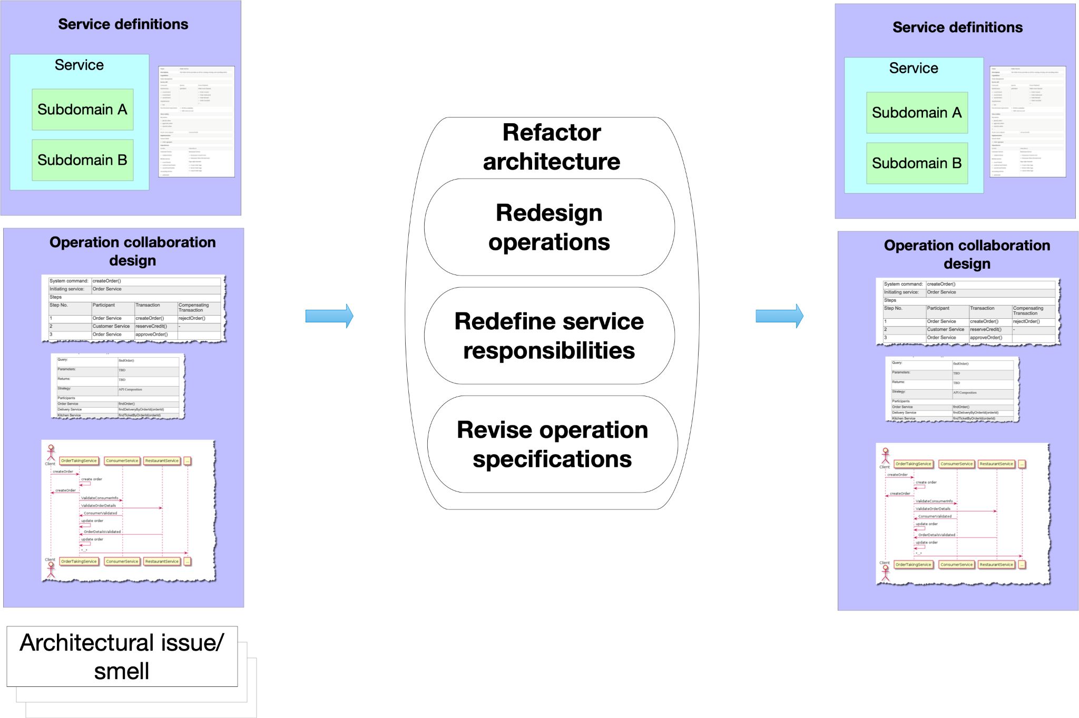

Slide 25
When to use this process
Defining a target architecture (e.g. monolithic or microservices) for greenfield development
Defining a target microservice architecture when refactoring a monolith to microservices
Implementing new or changing requirements
As part of an on-going architectural governance process that ensures that the architecture continues to satisfy its non-functional requirements

Slide 26
The microservice defines an approach to the architecture that divides an application into a pool of loosely coupled services that implements business requirements. It is next to Service-Oriented Architecture (SOA). The most important feature of the microservice-based architecture is that it can perform continuous delivery of a large and complex application.
Microservice helps in breaking the application and build a logically independent smaller applications. For example, we can build a cloud application with the help of Amazon AWS with minimum efforts.

Slide 27
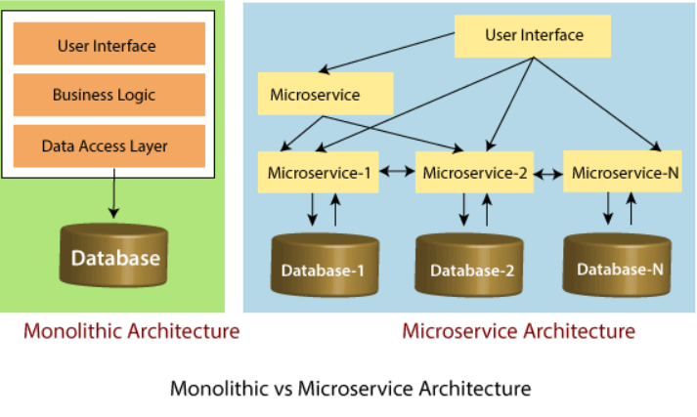

Slide 28
Principles of Microservices
There are the following principles of Microservices:
Single Responsibility principle
Modelled around business domain
Isolate Failure
Infrastructure automation
Deploy independently

Slide 29
Single Responsibility Principle
The single responsibility principle states that a class or a module in a program should have only one responsibility. Any microservice cannot serve more than one responsibility, at a time.

Slide 30
Modeled around business domain
Microservice never restrict itself from accepting appropriate technology stack or database. The stack or database is most suitable for solving the business purpose.

Slide 31
Isolated Failure
The large application can remain mostly unaffected by the failure of a single module. It is possible that a service can fail at any time. So, it is important to detect failure quickly, if possible, automatically restore failure.

Slide 32
Infrastructure Automation
The infrastructure automation is the process of scripting environments. With the help of scripting environment, we can apply the same configuration to a single node or thousands of nodes. It is also known as configuration management, scripted infrastructures, and system configuration management.

Slide 33
Deploy independently
Microservices are platform agnostic. It means we can design and deploy them independently without affecting the other services.

Slide 34
Advantages of Microservices
Microservices are self-contained, independent deployment module.
The cost of scaling is comparatively less than the monolithic architecture.
Microservices are independently manageable services. It can enable more and more services as the need arises. It minimizes the impact on existing service.
It is possible to change or upgrade each service individually rather than upgrading in the entire application.
Microservices allows us to develop an application which is organic (an application which latterly upgrades by adding more functions or modules) in nature.
It enables event streaming technology to enable easy integration in comparison to heavyweight interposes communication.
Microservices follows the single responsibility principle.
The demanding service can be deployed on multiple servers to enhance performance.
Less dependency and easy to test.
Dynamic scaling.
Faster release cycle.

Slide 35
Disadvantages of Microservices
Microservices has all the associated complexities of the distributed system.
There is a higher chance of failure during communication between different services.
Difficult to manage a large number of services.
The developer needs to solve the problem, such as network latency and load balancing.
Complex testing over a distributed environment.

Slide 36
Challenges of Microservices Architecture
Microservice architecture is more complex than the legacy system. The microservice environment becomes more complicated because the team has to manage and support many moving parts. Here are some of the top challenges that an organization face in their microservices journey:
Bounded Context
Dynamic Scale up and Scale Down
Monitoring
Fault Tolerance
Cyclic dependencies
DevOps Culture

Slide 37
Bounded context: The bounded context concept originated in Domain-Driven Design (DDD) circles. It promotes the Object model first approach to service, defining a data model that service is responsible for and is bound to. A bounded context clarifies, encapsulates, and defines the specific responsibility to the model. It ensures that the domain will not be distracted from the outside. Each model must have a context implicitly defined within a sub-domain, and every context defines boundaries.
In other words, the service owns its data and is responsible for its integrity and mutability. It supports the most important feature of microservices, which is independence and decoupling.

Slide 38
Dynamic scale up and scale down: The loads on the different microservices may be at a different instance of the type. As well as auto-scaling up your microservice should auto-scale down. It reduces the cost of the microservices. We can distribute the load dynamically.

Slide 39
Monitoring: The traditional way of monitoring will not align well with microservices because we have multiple services making up the same functionality previously supported by a single application. When an error arises in the application, finding the root cause can be challenging.

Slide 40
Fault Tolerance: Fault tolerance is the individual service that does not bring down the overall system. The application can operate at a certain degree of satisfaction when the failure occurs. Without fault tolerance, a single failure in the system may cause a total breakdown. The circuit breaker can achieve fault tolerance. The circuit breaker is a pattern that wraps the request to external service and detects when they are faulty. Microservices need to tolerate both internal and external failure.

Slide 41
Cyclic Dependency: Dependency management across different services, and its functionality is very important. The cyclic dependency can create a problem, if not identified and resolved promptly.

Slide 42
DevOps Culture: Microservices fits perfectly into the DevOps. It provides faster delivery service, visibility across data, and cost-effective data. It can extend their use of containerization switch from Service-Oriented-Architecture (SOA) to Microservice Architecture (MSA).

Slide 43
Other challenges of microservices
As we add more microservices, we have to be sure they can scale together. More granularity means more moving parts, which increase complexity.
The traditional logging is ineffective because microservices are stateless, distributed, and independent. The logging must be able to correlate events across several platforms.
When more services interact with each other, the possibility of failure also increases.

Slide 44
Difference between Microservices Architecture (MSA) and Services-Oriented Architecture (SOA)

Slide 45
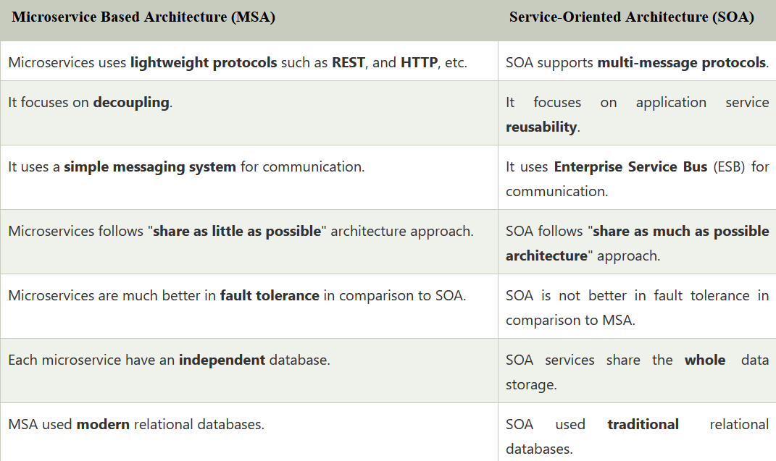

Slide 46
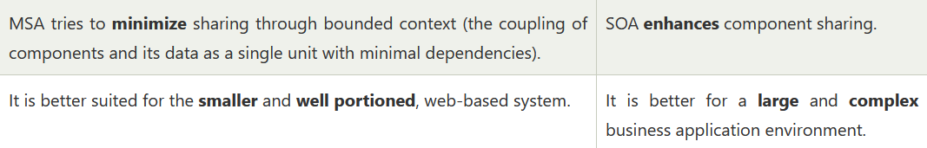

Slide 47
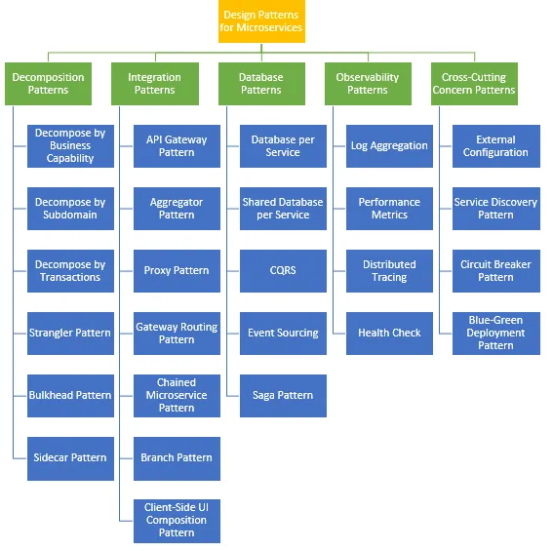

Slide 48
Microservices Monitoring
Monitoring is the control system of the microservices. As the microservices are more complex and harder to understand its performance and troubleshoot the problems. Given the vivid changes to software delivery, it is required to monitor the service. There are five principles of monitoring microservices, as follows:
Monitor container and what's inside them.
Alert on service performance.
Monitor services that are elastic and multi-location.
Monitor APIs.
Monitor the organizational structure.
These principles allow us to address technological changes associated with the microservices and organizational changes related to them.

Slide 49
Microservices Monitoring Tool
There are three monitoring tools are as follows:
Hystrix dashboard
Eureka admin dashboard
Spring boot admin dashboard

Slide 50
Components of Microservices
There are the following components of microservices:
Spring Cloud Config Server
Netflix Eureka Naming Server
Hystrix Server
Netflix ZuulAPI Gateway Server
Netflix Ribbon
Zipkin Distributed Tracing Server

Slide 51
Spring Cloud Config Server
Spring Cloud Config Server provides the HTTP resource-based API for external configuration in the distributed system. We can enable the Spring Cloud Config Server by using the annotation @EnableConfigServer.

Slide 52
Netflix Eureka Naming Server
Netflix Eureka Server is a discovery server. It provides the REST interface to the outside for communicating with it. A microservice after coming up, register itself as a discovery client. The Eureka server also has another software module called Eureka Client. Eureka client interacts with the Eureka server for service discovery. The Eureka client also balances the client requests.

Slide 53
Hystrix Server
Hystrix server acts as a fault-tolerance robust system. It is used to avoid complete failure of an application. It does this by using the Circuit Breaker mechanism. If the application is running without any issue, the circuit remains closed. If there is an error encountered in the application, the Hystrix Server opens the circuit. The Hystrix server stops the further request to calling service. It provides a highly robust system.

Slide 54
Netflix Zuul API Gateway Server
Netflix Zuul Server is a gateway server from where all the client request has passed through. It acts as a unified interface to a client. It also has an inbuilt load balancer to load the balance of all incoming request from the client.

Slide 55
Netflix Ribbon
Netflix Ribbon is the client-side Inter-Process Communication (IPC) library. It provides the client-side balancing algorithm. It uses a Round Robin Load Balancing:
Load balancing
Fault tolerance
Multiple protocols(HTTP, TCP, UDP)
Caching and Batching

Slide 56
Zipkin Distributed Server
Zipkin is an open-source project . That provides a mechanism for sending, receiving, and visualization traces.
One thing you need to be focused on that is port number.

Slide 57
